Slide 1


What’s important for further studies??
By Winnie Wetthasinghe
22/03/2021

Slide 2
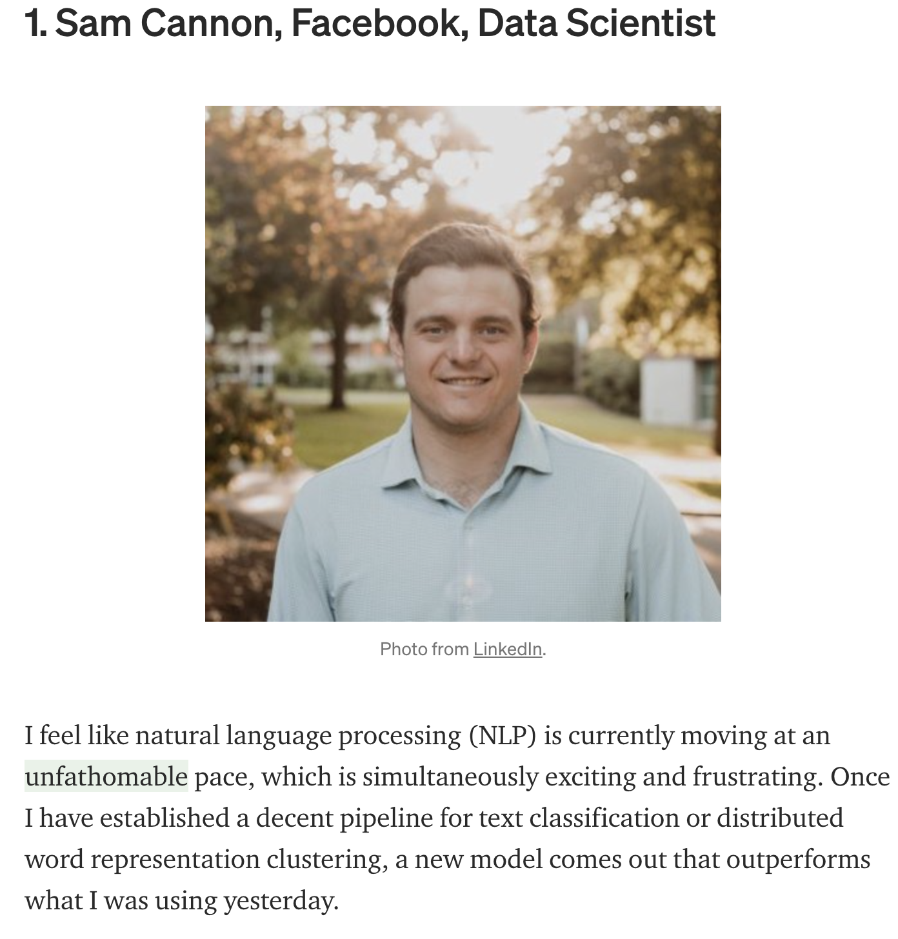
NLP ^{[1]}
“Moving at an unfathomable pace”
“Simultaneously exciting and frustrating”
“Frequent new models outperform already established pipelines or/ distributed clusters.”

Slide 3
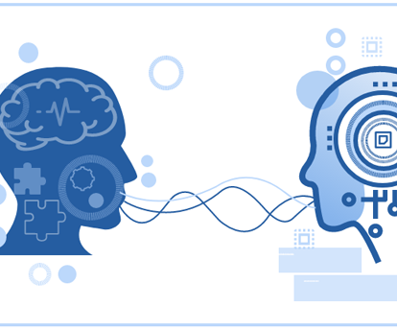
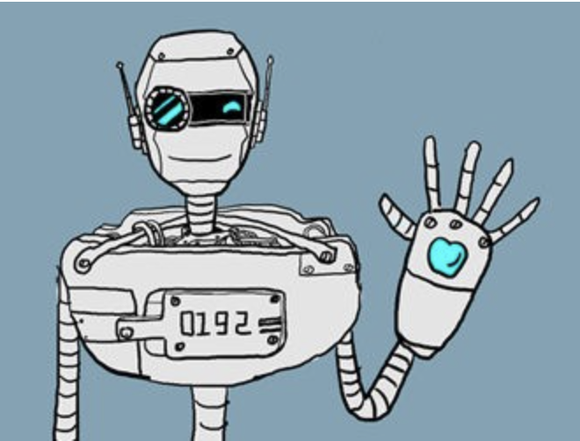
What is nlp? (Natural language processing)
Humans express with handling discourses that are ambiguous, having strong reference to context of where we live and work , catch subtle references to feelings and sentiment in text , enabling people to understand polite speech that hide negative feelings and irony etc. [2]
Computers cannot understand human language but can rely on NLP.
Developing applications and services that are able to understand human expressions - Makes sense of language using statistics and computers.

Slide 4
SImPLY What does it do?
Spot spam in your email –spam filtering
Tag part of conversation that contains a verb or noun
Predicting the stock market using news articles
Spot an entity like a name or company
Help understand ambiguous phrases like “mouse”. Is it the animal or the computer device?

Slide 5

nlp areas
Topic Identification- extracting meaning from texts and by identifying recurrent themes and topics
Text classification
Chatbots
Translations
Sentiment analysis and etc

Slide 6
QUICK DIVE INTO REGULAR EXPRESSIONS (Regex)
They form a part of basic techniques in NLP
They are string with special syntax, that allow you to match patterns and find other strings. Pattern is a series of letters or symbols.
Using regular expressions: we can find all web links in a document, parse email address, remove/replace unwanted characters.
Match a substring by using re.match (), that matches pattern with a string.

Slide 7
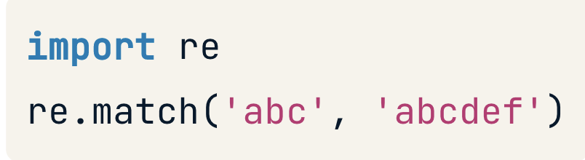

Slide 8
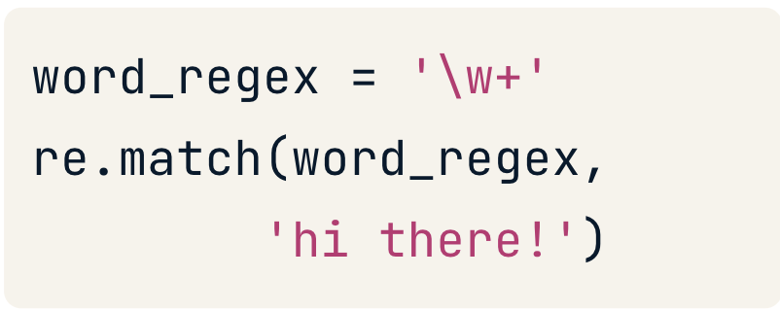
Tune in……more from the Data Science and AI course…

Slide 9
NLP Implementations^{[4]}
Search engines like Google, Yahoo, etc. Google engine understands that you are into Data Science, so it shows you results related to you.
Speech engines (digital assistant) like Siri, Cortana, smart home hubs etc. (Natural Language Search)
Spam filters like Google spam filters. Now it’s not just about usual spam filtering, the spam filters understand what’s inside the email content and see if it’s a spam or not.
We use these everyday and so frequently and by how many. No wonder the models are changing by the day. (remember going back to what Sam Cannon said)

Slide 10
He also mentioned that
“Solutions for NLP tasks are complicated
“Lack of expertise in the area.”
“We need simple analysis solutions that require minimal user inputs.”
“It is still impossible to forecast what will truly be accomplished in this space 2021”
“Hopefully, there’ll be more out-of-the-box NLP models in the future.” and more Data Scientists working in this area?

Slide 11
THANK YOU!

Slide 12
Reference
https://betterprogramming.pub/the-future-of-data-science-data-engineering-and-tech-7f0a503745fd
https://www.dummies.com/programming/natural-language-processing-machine-learning/
https://campus.datacamp.com/courses/introduction-to-natural-language-processing-in-python/regular-expressions-word-tokenization?ex=1
https://towardsdatascience.com/gentle-start-to-natural-language-processing-using-python-6e46c07addf3

